Slide 1
HOSTEL MANAGEMENT SYSTEM
ASWATHI K S
LNCE18MCA017

Slide 2
INTRODUCTION
The “HOSTEL MANAGEMENT SYSTEM” has been developed to override the problems prevailing in the practicing manual system. The software is supported to reduce the hardships faced by the existing system. HOSTEL MAANGEMENT SYSTEM is a web application that aims at computerization of the current procedure of allocating hostel rooms. Currently the process involves students filling up the forms and submitting them in the respective hostel offices which involves a lot of paperwork, hence less efficient. However, every hostel has an administrator and represent using the administrator entity. Eventually they can add, delete, view he student details etc…

Slide 3
EXISTING SYSTEM
More human error
More manual labour needed
Record keeping difficult
Difficult to update data
Security
Less efficient

Slide 4
PROPOSED SYSTEM
Less time consuming.
Avoid manual error.
Simple structure.
Security.
Easy to use.

Slide 5
MODULE DISCRIPTION
ADMIN
Login
Appoint/ Remove hostel manager
Search student using id
Provide contact details
Edit profile
logout

Slide 6
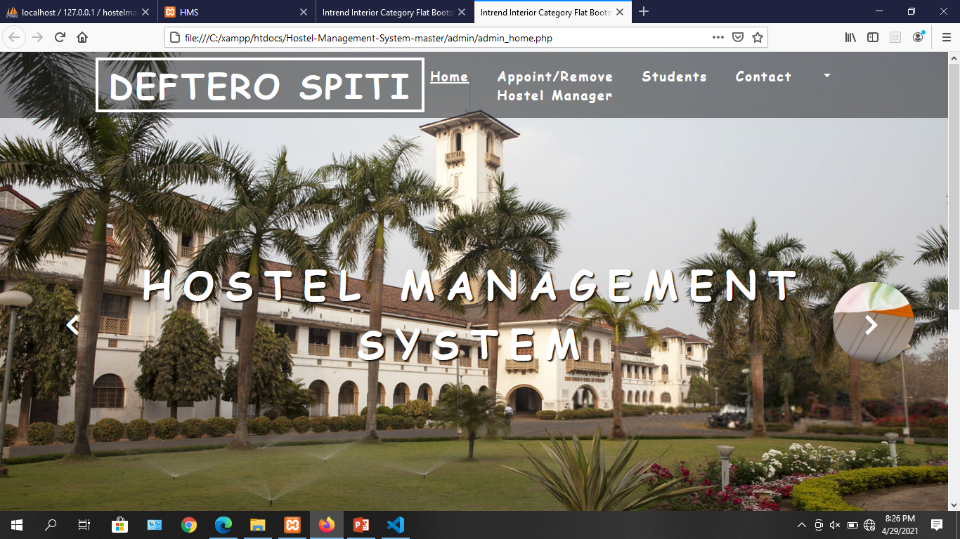

Slide 7
2) HOSTEL MANAGER
Login
Allocate rooms
Receive messeges from hostelers
Can see the allocated rooms, Empty rooms, and also vacate rooms
Provide contact details
Update profile
Logout

Slide 8
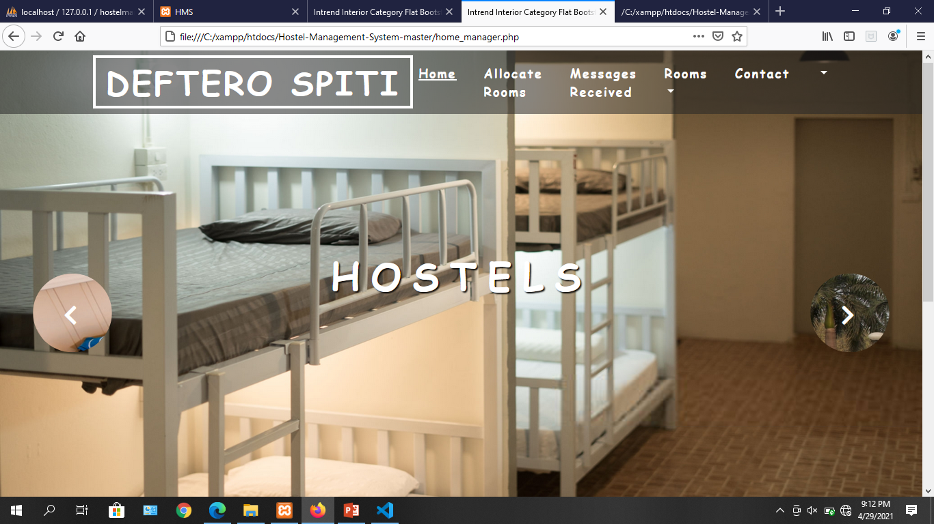

Slide 9
USER
Signup
Login
Apply for room
Receive message from hostel manager
Contact
Edit profile
Logout

Slide 10
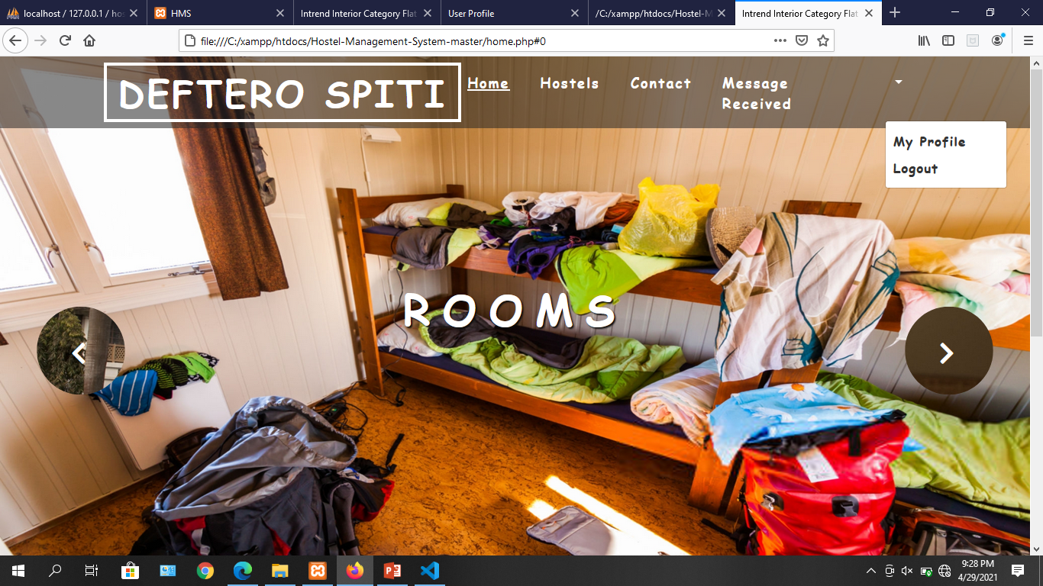

Slide 11
SOFTWARE REQUIREMENTS
FRONT END : PHP
BACK END : MYSQL
OS : WINDOWS
HARDWARE REQUIREMENTS
PROCESSOR : INTEL CORE i3
HARD DISK : 120GB
RAM : 4GB
INPUT DEVICES : KEYBOARD, MOUSE

Slide 12
CONCLUSION
To conclude about the project, the HOSTEL MANAGEMENT SYSTEM is a web application developed in php and mysql. It will be one of helping web application for who searching for an hostel facility.

Slide 13
THANK YOU

